Slide 1
Disease Prediction Using Machine Learning

Slide 2
Approach
Gathering the data
Cleaning the data
Model Building
Inference

Slide 3
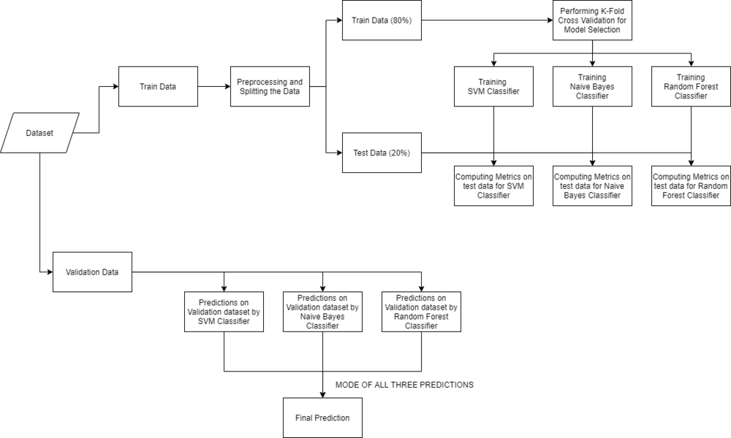

Slide 4
Dataset
Training data
https://www.kaggle.com/datasets/kaushil268/disease-prediction-using-machine-learning?select=Training.csv
Testing Data
https://www.kaggle.com/datasets/kaushil268/disease-prediction-using-machine-learning?select=Testing.csv

Slide 5
Reading Dataset using Panda Module
To read data from csv files, we use panda Module
DATA_PATH = "dataset/Training.csv"
data=panda.read-csv(DATA_PATH).dropna(axis=1)
###drop columns containing missing values

Slide 6
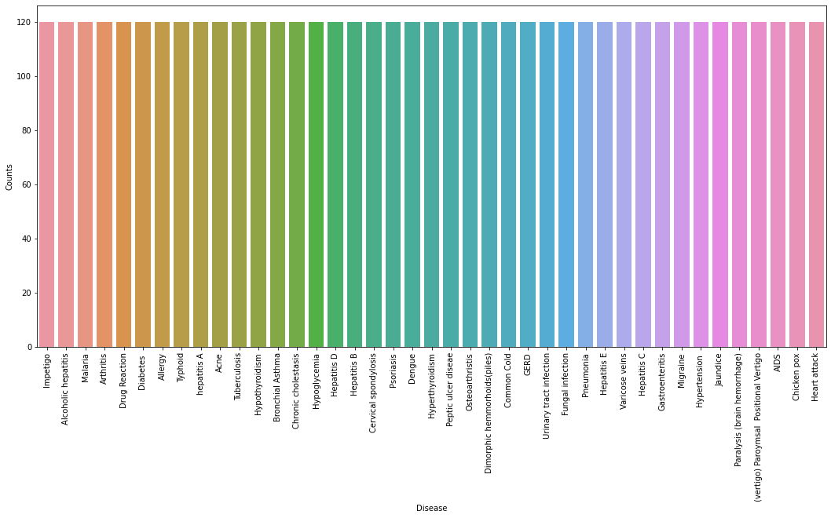
Test if data is balanced

Slide 7
Transform values of diseases to numerical values
Use
from sklearn.preprocessing import LabelEncoder
encoder =LabelEncoder()
data["prognosis"] = encoder.fit_transform(data["prognosis"])

Slide 8
Training and Test Data:split data
X = data.iloc[:,:-1]
y = data.iloc[:, -1]
X_train, X_test, y_train, y_test =train_test_split(
X, y, test_size = 0.2, random_state = 24)
print(f"Train: {X_train.shape}, {y_train.shape}")
print(f"Test: {X_test.shape}, {y_test.shape}")

Slide 9
Model Building
Machine learning Model:
Support Vector Classifier,
Gaussian Naive Bayes Classifier,
Random Forest Classifier
K-Fold cross-validation to evaluate the machine learning models

Slide 10
Support Vector Machine:SVM
Support Vector Classifier is a discriminative classifier i.e. when given a labeled training data, the algorithm tries to find an optimal hyperplane that accurately separates the samples into different categories in hyperspace.

Slide 11
Gaussian Naive Bayes Classifier
Naive Bayes is used in text classification, document classification and for document indexing. In naive bayes, each possible feature does not have any weight assigned in the pre-processing phase and the weights are later assigned during training as well as recognition phases. The basic assumption of naive bayes algorithm is that features are independent.

Slide 12
Random Forest Classifier
Random Forest is an ensemble learning-based supervised machine learning classification algorithm that internally uses multiple decision trees to make the classification. In a random forest classifier, all the internal decision trees are weak learners, the outputs of these weak decision trees are combined i.e. mode of all the predictions is as the final prediction.

Slide 13
K-Fold Cross-Validation
K-Fold cross-validation is one of the cross-validation techniques in which the whole dataset is split into k number of subsets, also known as folds, then training of the model is performed on the k-1 subsets and the remaining one subset is used to evaluate the model performance.
Use
cross_val_score

Slide 14
Combining Models
After training and testing three model
The result is a statistic mode of three Model (result that is redundent in the majority of Models)

Slide 15
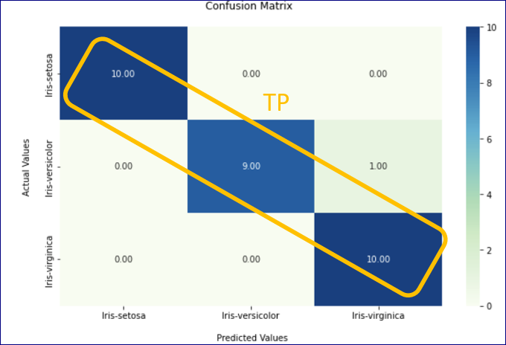
Confusion Matrix
The confusion matrix is an n*n matrix that is used to measure the performance of classification models.

Slide 16
Confusion Matrix: Metrics
Metrics that could be extracted from confusion matrix are:
Accuracy: how often the model is correct
Use accuracy_score (metrics from sklearn)
Precision: Of the positives predicted, what percentage is truly positive?
Use precision_score (metrics from sklearn)
Recall: Sensitivity (sometimes called Recall) measures how good the model is at predicting positives.
Use recall_score (metrics from sklearn)
Specificity: How well the model is at prediciting negative results?
Use recall_score (metrics from sklearn)
F-score: F-score is the "harmonic mean" of precision and sensitivity.

Slide 17
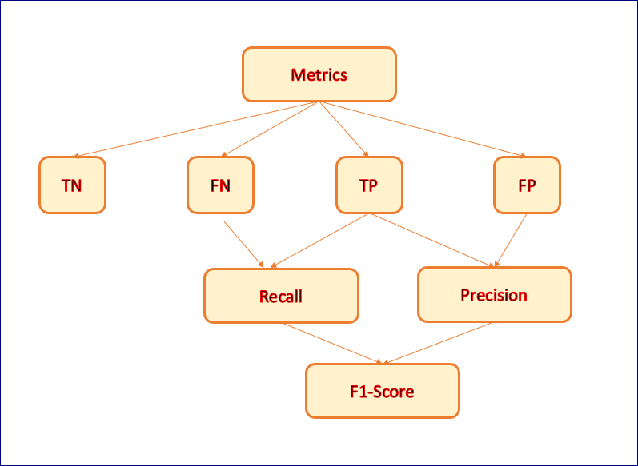

Slide 18
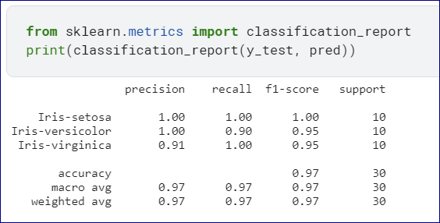
Classification Report
The classification report will display the performance metrics of the classification model.
It will display metrics like precision, recall,f1-score, and support for each class.
It also displays metrics like accuracy, macro avg, and weighted avg.

